Slide 1
Fast Application Overview
Sana Ullah Khan

Slide 2
Agenda
What’s FAST TS ?
FAST History.
FAST Application Model.
FAST Infrastructure.
Installation Guidelines.
Application Overview.

Slide 3
What is the FAST Transaction System ?
FAST is a enterprise-wide web-based, title and escrow transaction system designed to be flexible to support the needs of the business corporate-wide.

Slide 4
FAST History
FAST has been an idea for many, many years
Current FAST is the 3rd attempt
Started in October, 1998, with a team of 3
Initial project kicked off January 1999, deploying the first release in August 1999.
Major Milestones
  Release 1 – Basic Title – August 1999
  Release 2 – Basic Escrow – August 2000
  Full rollout to all of First American Direct Offices - 2002
  Site Certification / Workflow Changes - 2003

Slide 5
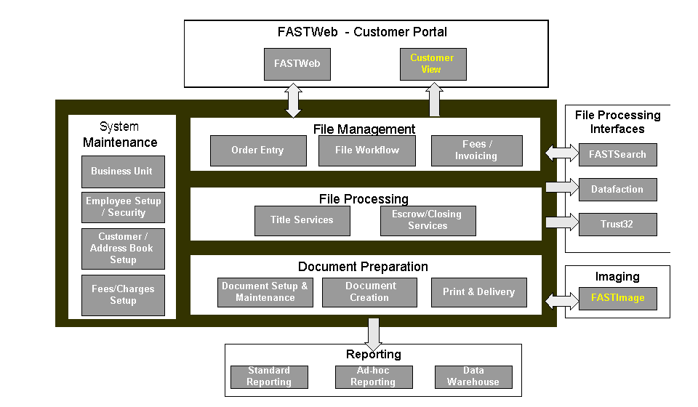
FAST Application Model

Slide 6
FAST Infrastructure
IIS Servers – 60
  Front end web server supporting GUI and BO
Interface Servers – 3
  Supports the interfaces to the client portals
Delivery Servers – 70
  Produces all “products” using MS Word
Check Printing Servers – 7
  Produces Checks and other system documents using LaTeX
SQL Server - 1
  Unisys ES7000
  EMC – SAN array
  Stores the FASTProd (250 GB) and FASTArchive (150 GB) databases
FAST Agent Server – 2
  Supports the interface to FASTSearch, which provides automated Title Search
Other Supporting Servers
  Exchange - 1
  Fax - 4

Slide 7
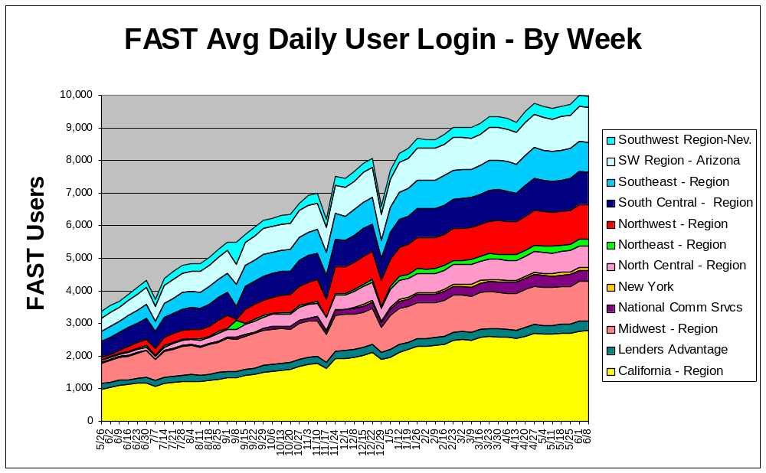
FAST Weekly Distinct Average User Logins

Slide 8
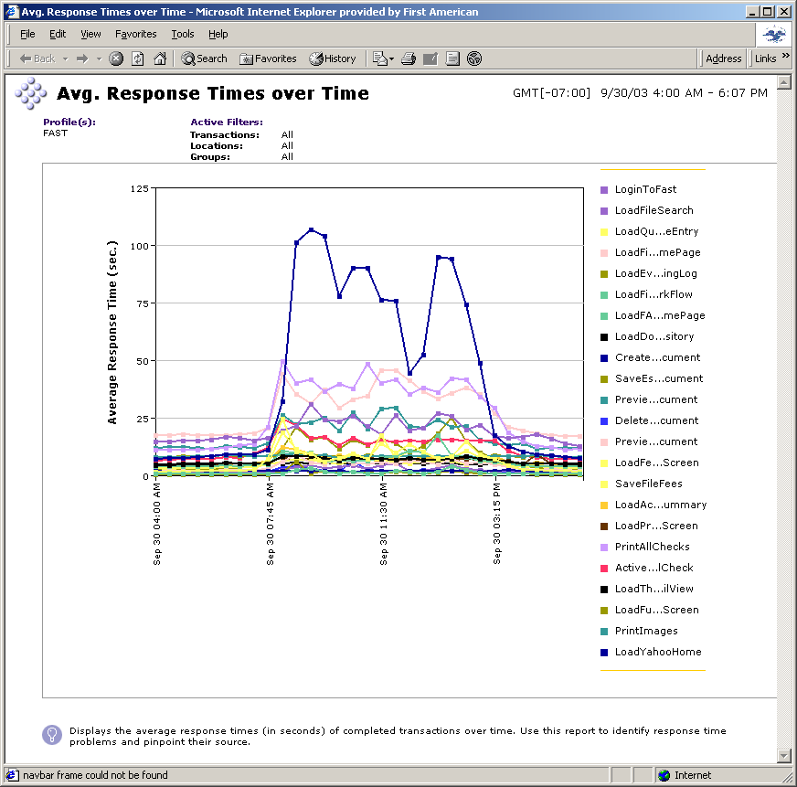
Bad day in FAST

Slide 9
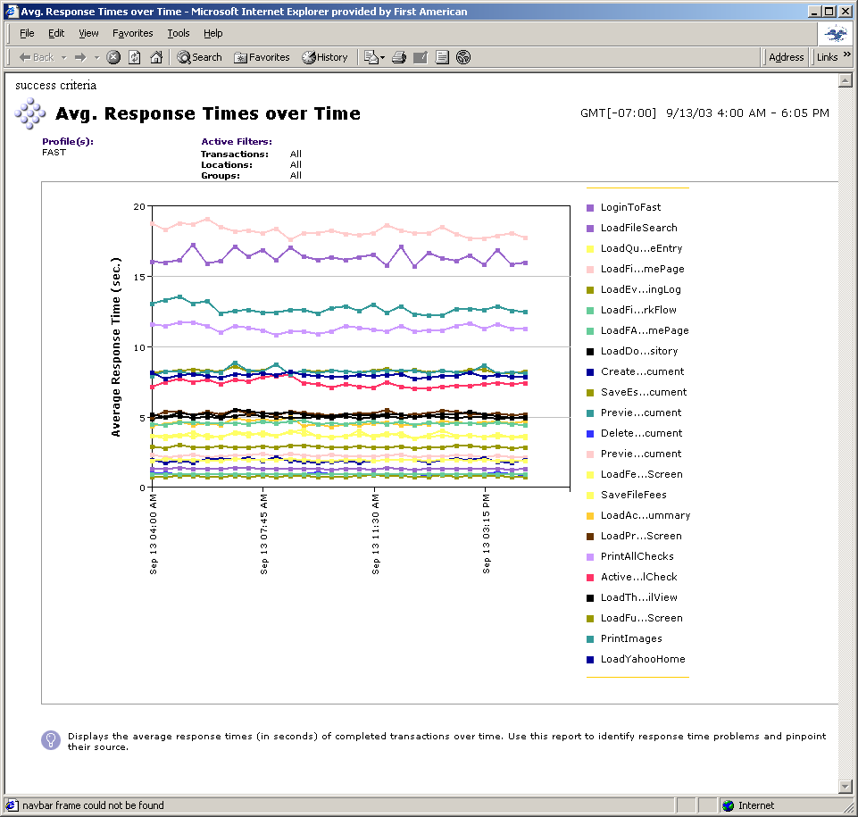
Good day in FAST

Slide 10
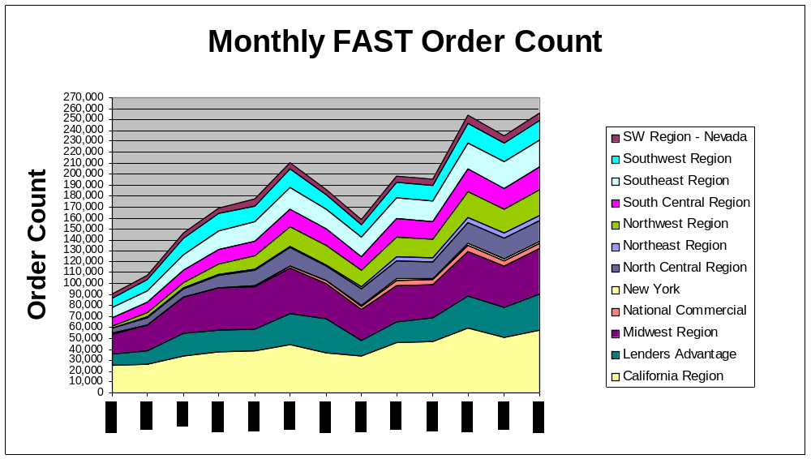
FAST Monthly Order Count

Slide 11
Installation
Create FASTInstall.ini in C:\winnt folder (Sample is provided)
Install the application from the given location
Some important data to note
  Registry entry values in HKLM\SOFTWARE\SMS
    Connection String value Default_Connection from HKLM\SOFTWARE\SMS\FAST\DAL\
    Queuepathname from HKLM\SOFTWARE\SMS\DocumentDelivery
  Virtual Directories smsfast, XMLBroker2
    SMSFast is configured to have basic authentication
    XMLBroker2 is configured to have anonymous authentication
  Log files folder C:\CM\Logs

Slide 12
Overview(Functionality Based)
File Management
  Order creation and maintenance
Escrow
  Charge processing
  Closing
Docprep and Delivery
  Document creation and maintenance
  Document generation and delivery
External Interface
  FastWeb (Internet)
  WinTrack (Legacy)
  FastSearch (Title search)

Slide 13
Frames in the GUI Framework
MRU List
Top Frame for toolbar support
View frame (Actual Page) .
Left frame for Tree view support
The Main Application Frame
Status bar and framework buttons

Slide 14
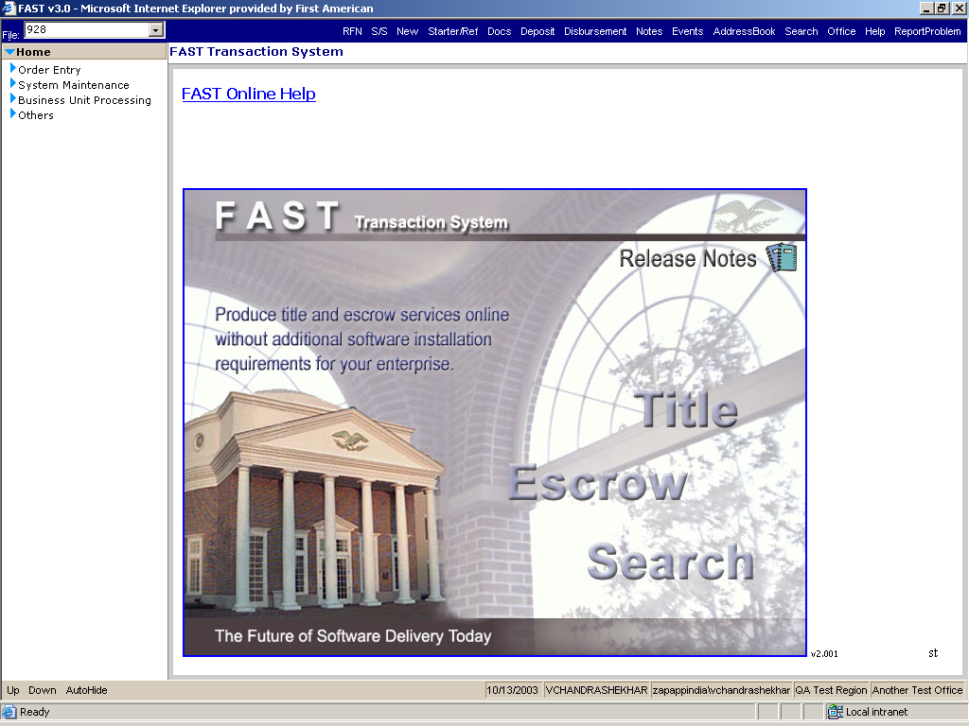
Fast Home

